Slide 1
Accident risk analysis
By, NIKUNJ SANGHAI (17BME0712)
SOMONNOY BANERJEE(18BCE2149)
(All data used has been collected from Ministry of Road transport and highways)

Slide 2
STATISTICAL TOOLS AND SOFTWARES USED
The two statistical tools used in the analysis were :
1.Properties of independent events (Probability)
2.Z-test (test of significance between two sample proportions
SOFTWARE USED TO VERIFY THE RESULT WAS R
As we know road safety is not dependent on just one factor in this analysis we have broken down road safety factors and risks and ways so that we can minimize fatalities on road .
Parameters studied were:
1.Weather condition
2.Vehicle type
3.Age group of people
4.Vehicle age
5.Road type
6.Types of violation committed .

Slide 3
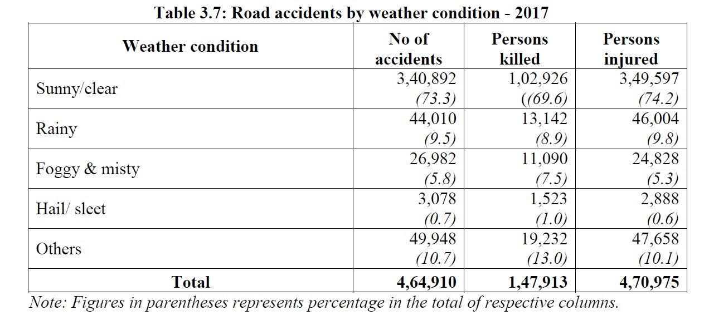
DATA COLLECTED ON WEATHER CONDITIONS

Slide 4
Explanation Of The Drastic Variations
The data used did not take showed most accidents occurred on a sunny day but did not take into account the proportionality of the number of sunny days in a year .
Basically the probability of number of accidents occurring on a sunny day P(z)
Can be represented as a product of two independent events
Proportional probability(risk) of an accident on a sunny day P(a)
Probability that a day will be sunny P(s)
P(z)=P(a)*P(s)
Thus to find out the risk in case number 1: sunny day , we do
P(a)=P(z)/P(s)
Thus the total accident probability P(z) on various days and second graph is of risk of accident on various days

Slide 5
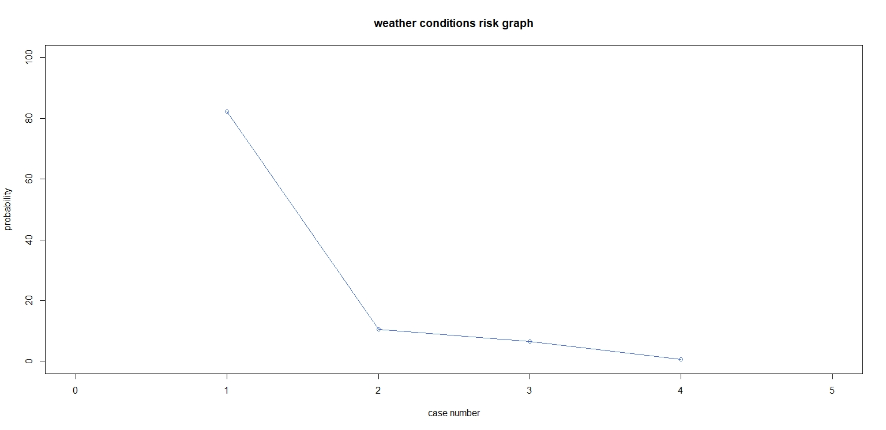
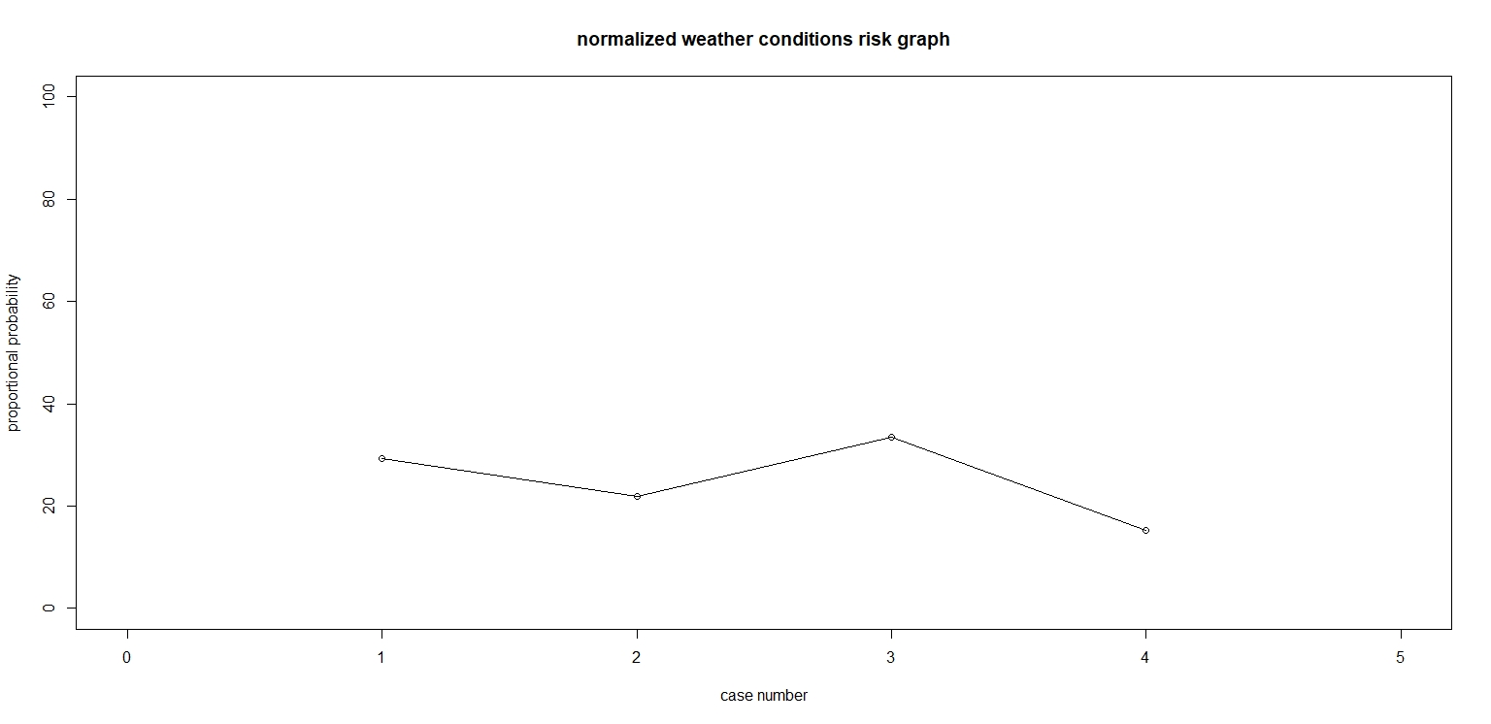
Weather conditions risk analysis
Sunny days :290
Rainy days:50
Foggy days:20
Hailstorm :5
IN BOTH THE GRAPHS
Case 1:sunny day
Case 2:rainy day
Case 3:foggy day
Case 4:hailstorm

Slide 6
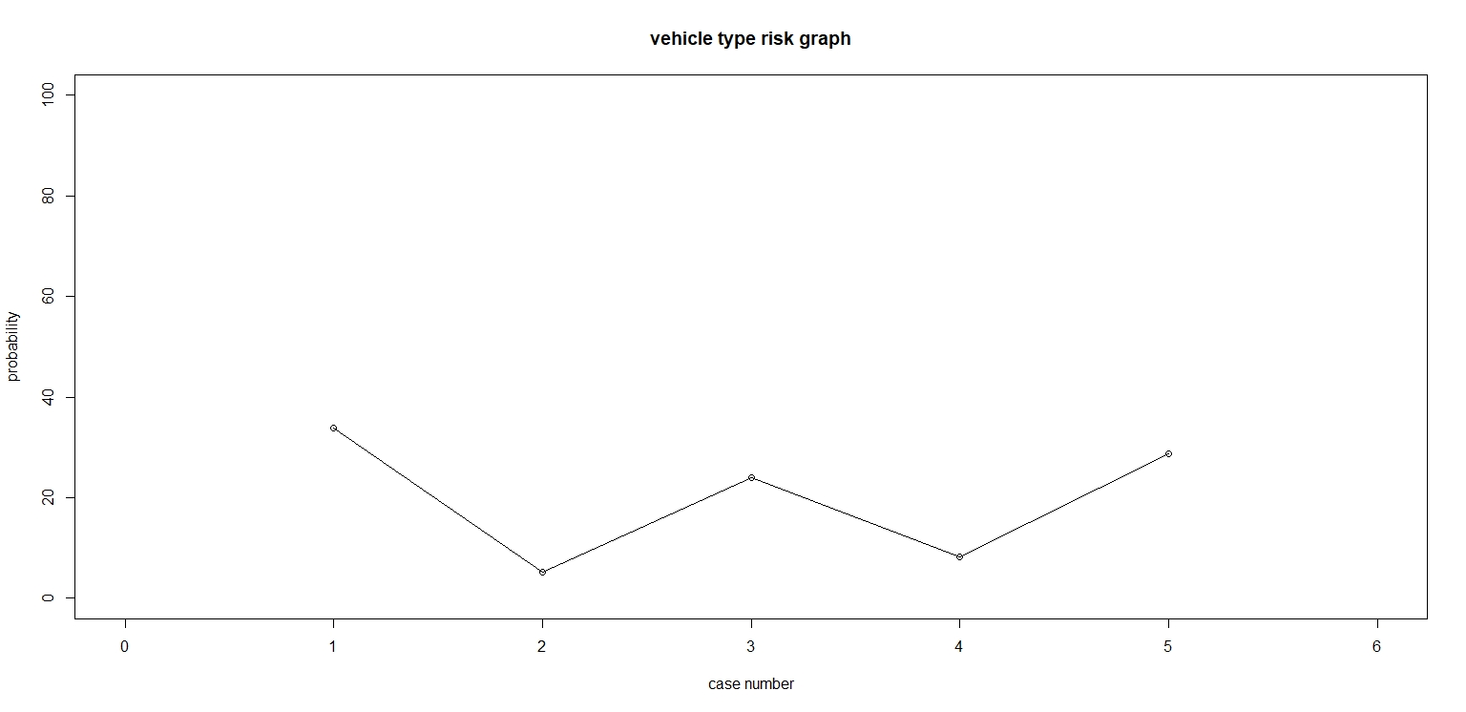
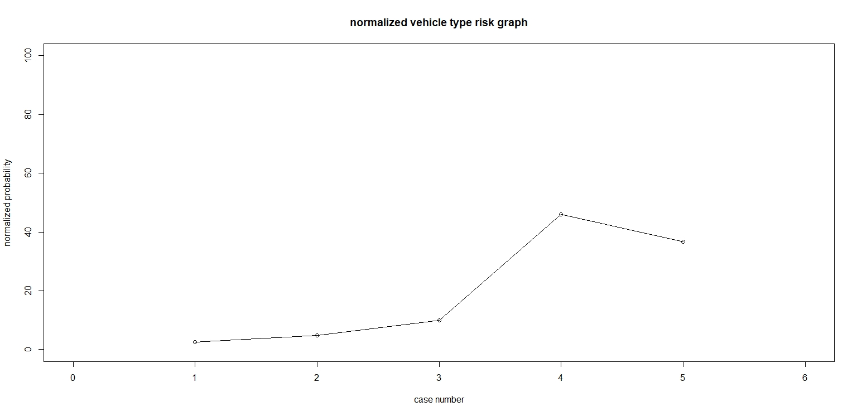
VEHICLE TYPE RISK ANALYSIS
Two wheelers:73.5%
Auto:6%
Four wheelers:13.6%
Buses:1%
Goods carrier:4.4%
Case 1: two wheelers
Case 2:auto
Case 3:four wheelers
Case 4:buses
Case 5:goods carrier

Slide 7
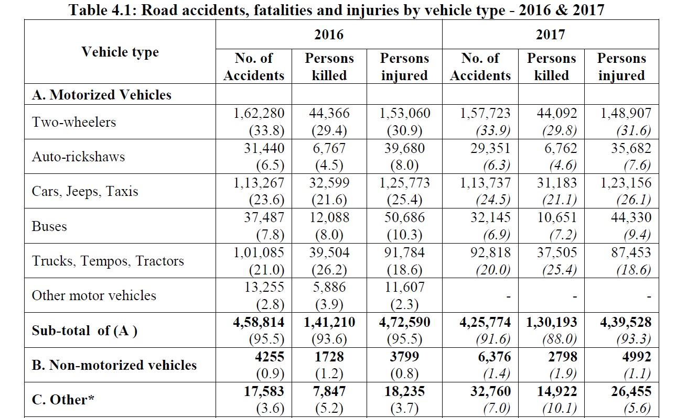
Reference data

Slide 8
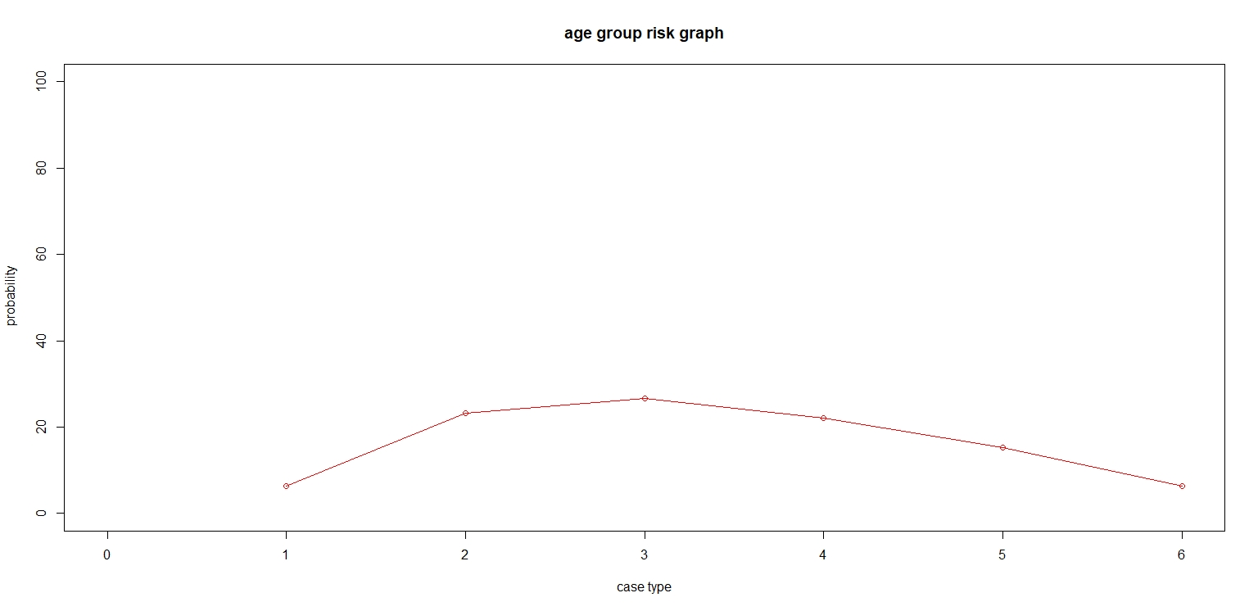
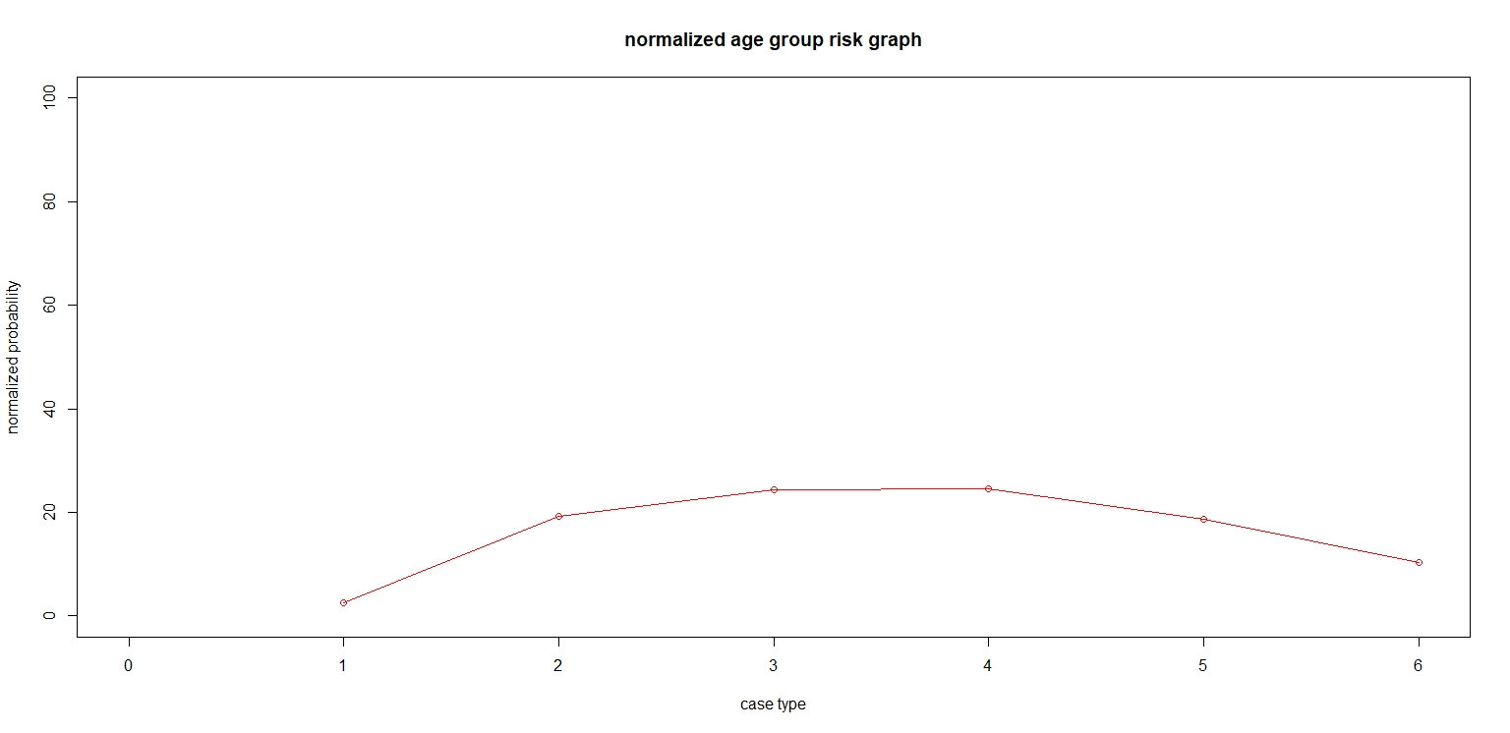
AGE GROUP RISK ANALYSIS
0-18 age: 34.87%
18-25 age:16.92%
25-35 age:15.48%
35-45 age:12.684%
45-60 age:11.44%
60+ age :8.608%
Case 1: 0-18 age
Case 2:18-25 age
Case 3:25-35 age
Case 4:35-45 age
Case 5:45-60 age
Case 6:60+ age

Slide 9
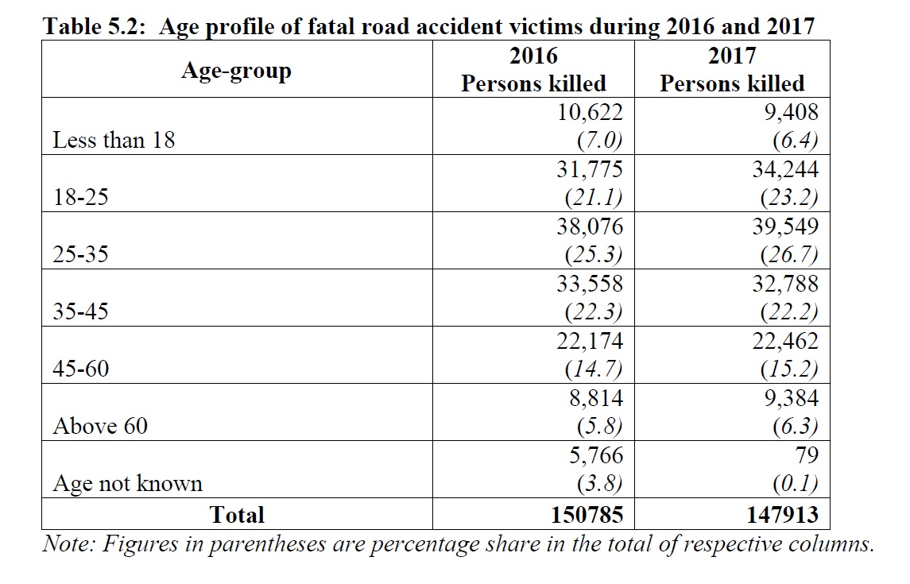
Reference data

Slide 10
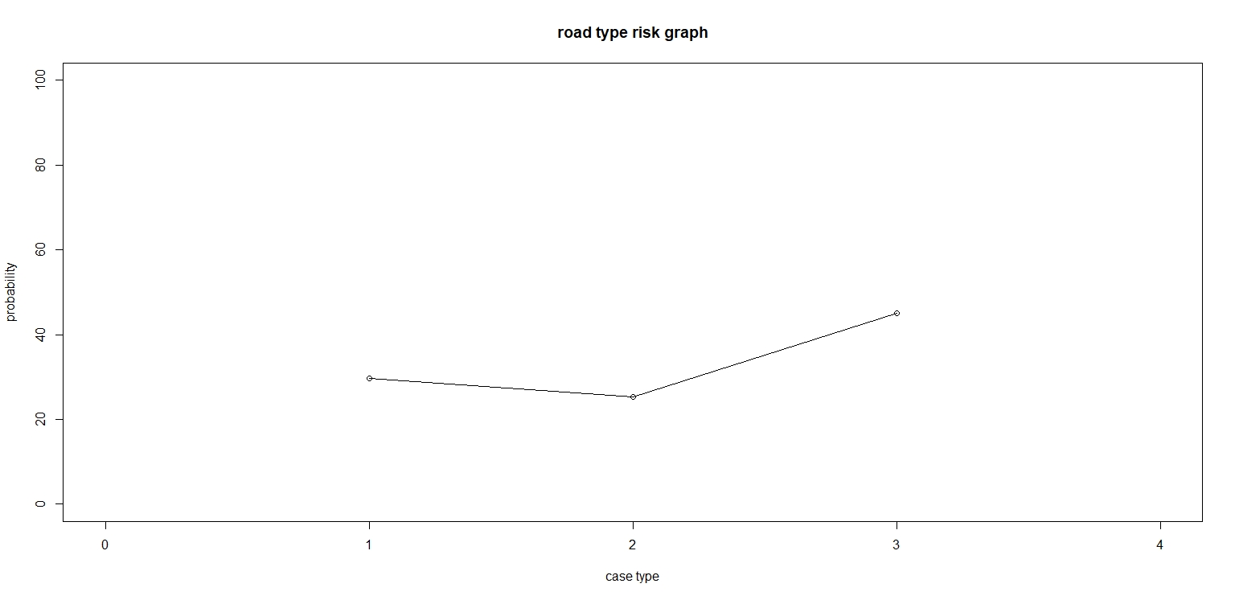
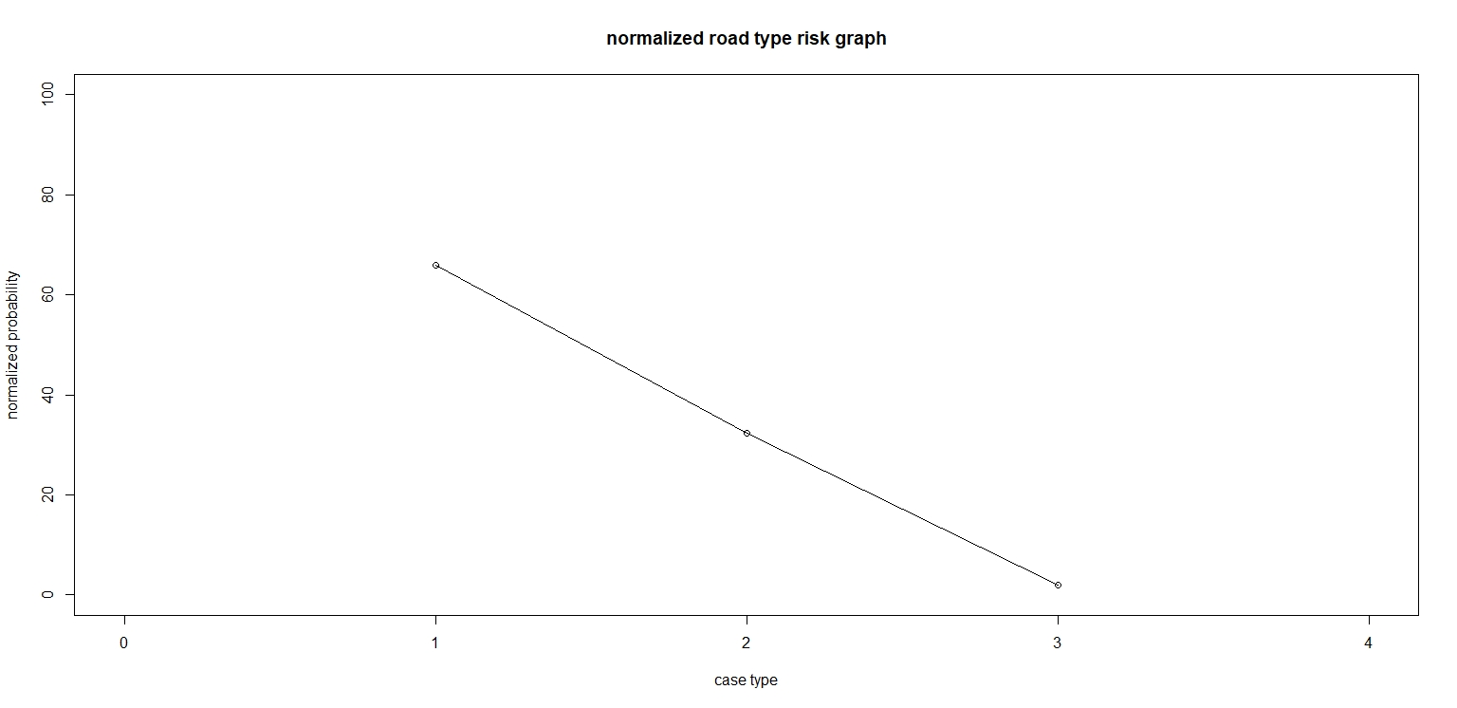
ROAD TYPE RISK ANALYSIS
NH-1.80%
SH-3.14%
Side roads-95.107%
Case 1:national highways
Case2:state highways
Case 3:other local roads

Slide 11
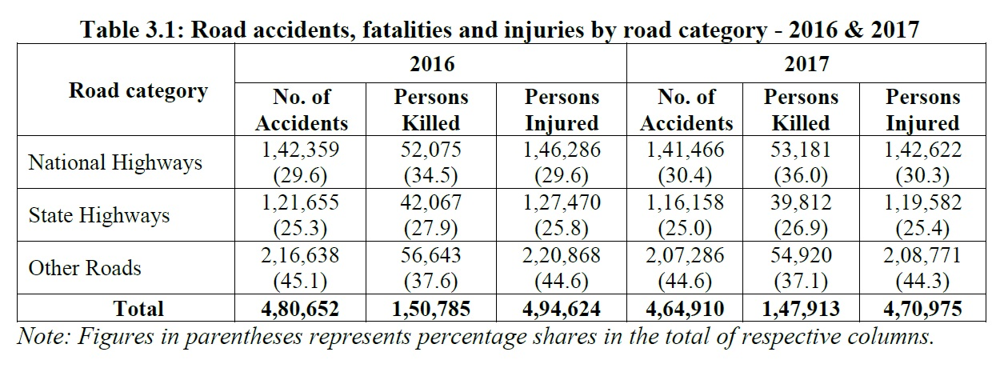
Reference data

Slide 12
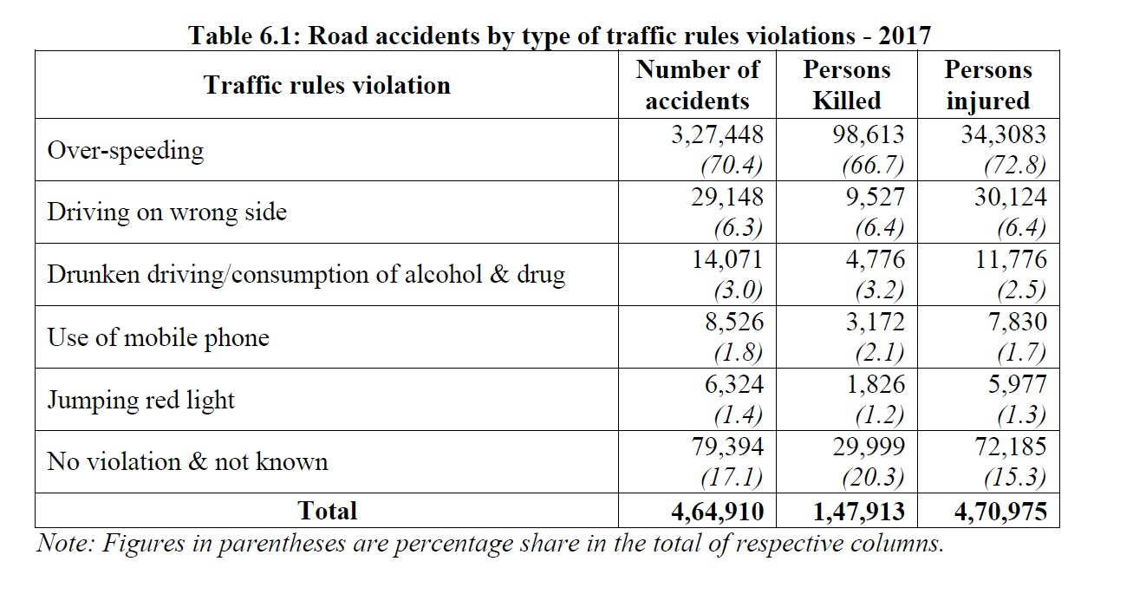
Fatality risk analysis by type of violation committed

Slide 13
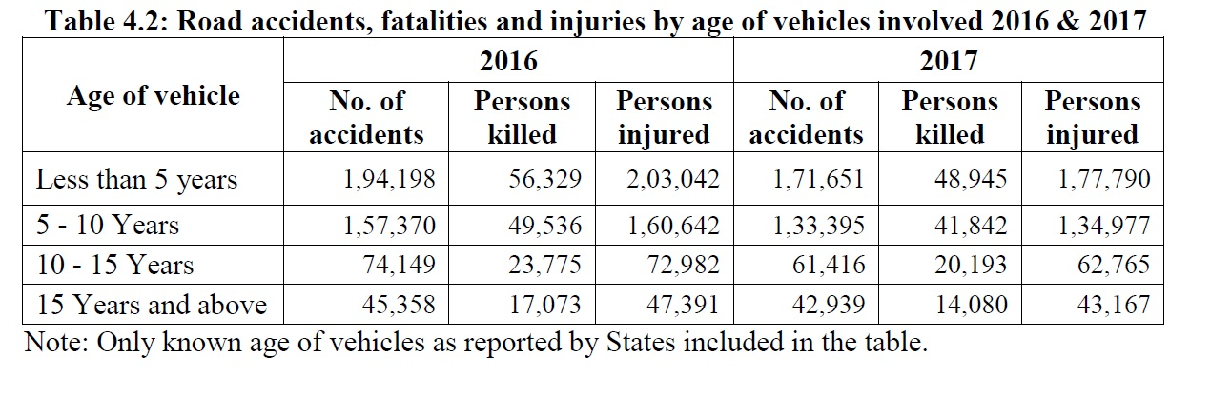
Fatality risk analysis by vehicle age

Slide 14
Applications
As we know the resources in our country are limited and government spends crores on road safety initiatives, the conclusions and proofs (using z tests) can enhance the effectiveness of money and time spent on road safety initiatives saving countless more lives.
Conclusions drawn from the z tests and normalized graphs :-
1.At first glance it looks as if the risk of an accident on a sunny day is greatest but considering the number of days and weather distribution it was determined that risk of an accident is greatest on an foggy day.
2.It was determined that the probability of a fatal accident too is significantly greater than a normal day on a foggy day (verified using z test)
3.At first glance it seems that 2-wheelers are most prone to accidents but in reality buses and goods carriers are most prone to accidents on road as proved by the normalized graph.
4.It was proved using z test that the probability of a fatal accident is also significantly greater in case of both buses and good carriers than that of a normal mean fatality probability of an accident .
5.Just by focusing on 1.8% of total road length we can prevent more than 25% of the deaths on roads .
6.The fatality risk of a mobile phone related accident is significantly more than other offenses.
7.The fatality risk of a vehicle more than 15 years of age is significantly more than other vehicles.

Slide 15
Conclusion
BASED ON THE VARIOUS DATA SETS USING GIVEN GRAPHS AND Z TESTS WE HAVE FOUND ENHANCED RESULT WHICH CAN HELP THE GOVERNMENT AND OTHER CIVIC BODIES HAVE BETTER UTILIZATION OF FUNDS .
WHICH INTURN CAN SAVE THOUSANDS OF LIVES

